Slide 1
Product Designing using RL
Case study: Layout design of a green house

Slide 2
Content
Intro to RL
Methodology
Result
Future Work
Appendix

Slide 3
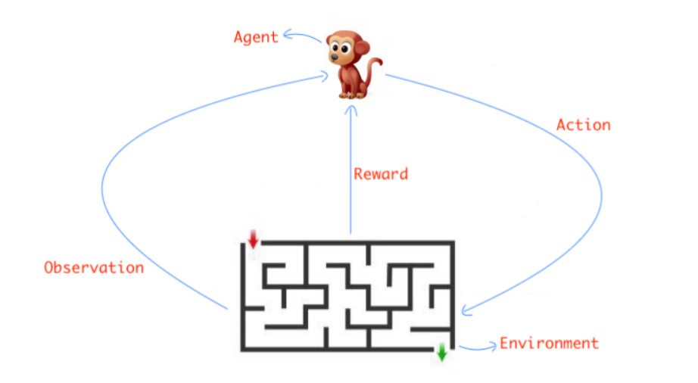
Intro to RL

Slide 4
Intro to RL (cont.)
Components
Heater
Water Tank
Pack Soil
Heat Sensor
Camera
Fan
LED
Water Pump
PCB
Pipes

Slide 5
Intro to RL (cont.)
Objectives
Minimize distance between pack soil, water tank and water pump.
Minimize distance between heater and the fan.
Maximize distance between LED and heat sensor
Maximize distance between heater and heat sensor
Maximize lighting of pack soil by the LED
Maximize view of pack soil captured by the camera

Slide 6
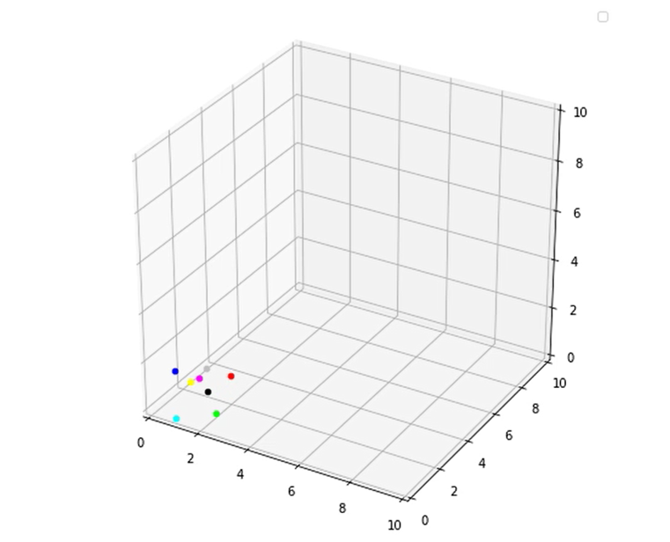
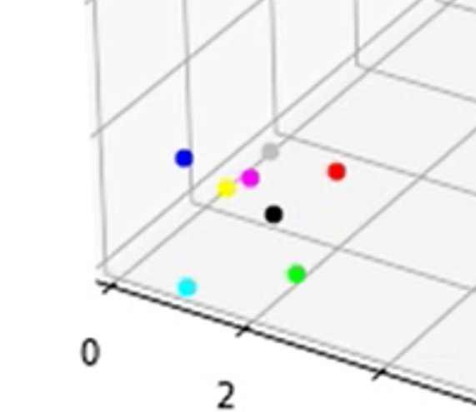
Environment and Agents
Intro to RL (cont.)

Slide 7
Reward System
Intro to RL (cont.)
Reward Value | Reward Info
-1 | Move away from the objective
0.5 | Maintain the same distance
2 | Move closer to the objective
5 | Move closer and find a similar best score
10 | Move closer and find a new best score

Slide 8
Methodology
Q-Learning
Q-Table
Action: Explore vs Exploit
Update Q-Table:
where s->state, a->action, lr->learning rate, r->reward,
Γ->discount factor, s’->new state
https://towardsdatascience.com/simple-reinforcement-learning-q-learning-fcddc4b6fe56#:~:text=Q%2Dlearning%20is%20an%20off,a%20policy%20isn't%20needed.

Slide 9
Methodology (cont.)
Why Q-Learning?
Learns in each step
Model-free
Works in non terminating environments
Continuous problem

Slide 10
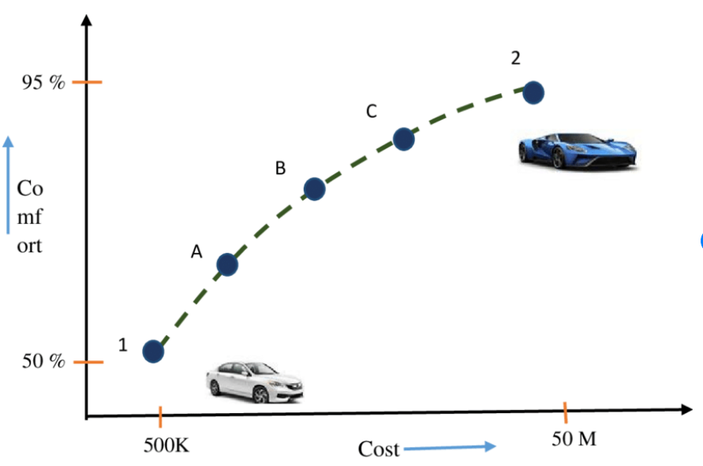
Methodology (cont.)
Multi Objective RL
When more than one objective is needed to be solved
Example: Buy a car with minimum cost and maximum comfort

Slide 11
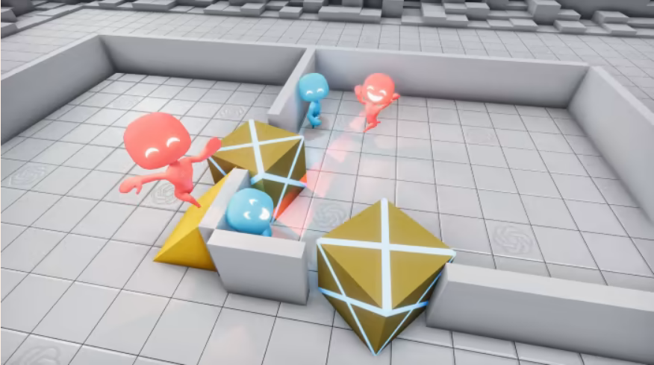
Methodology(cont.)
Multi Agent Multi Objective RL
When there is more than one agent having their own set of objectives.
Example: hide and seek

Slide 12
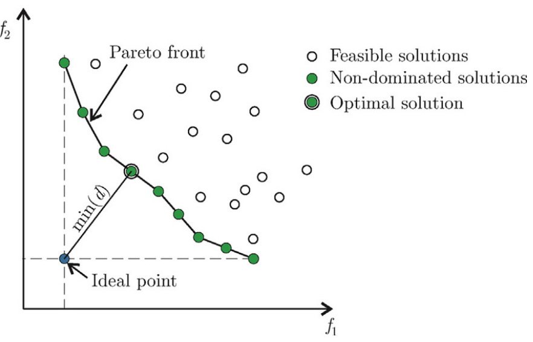
Result
Pareto Front
The set of non-dominated solutions, where each objective is considered as equally good.
Conflicting Objectives

Slide 13
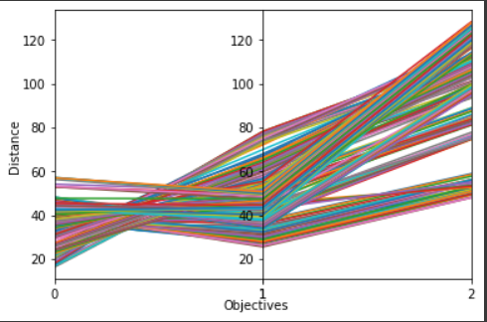
Result
Pareto Front
Total Rewards = 100k
Number of Objectives = 3
Objective 0 = Minimize
Objective 1 = Minimize
Objective 2 = Maximize

Slide 14
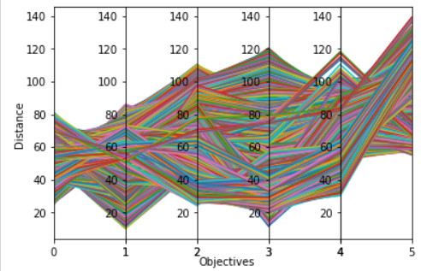
Result
Pareto Front
Total Rewards = 100k
Number of Objectives = 6
Objective 0 = Minimize
Objective 1 = Minimize
Objective 2 = Maximize
Objective 3 = Maximize
Objective 4 = Minimize
Objective 5 = Minimize

Slide 15
Future Work
Next Steps
Implement Deep Q Neural Network
Model-free
Has Experience Buffer
Implement SARSA
Learns near-optimal policy unlike Q-Learning that learns optimal policy
Implement Hybrid Model-Free Algorithm
Combines strength of Q-Learning and Policy Gradients
Deep Deterministic Policy Gradients (DDPG),Soft Actor -Critic (SAC),Twin Delayed Deep Deterministic Policy Gradients (TD3)
https://smartlabai.medium.com/reinforcement-learning-algorithms-an-intuitive-overview-904e2dff5bbc

Slide 16
Thank You

Slide 17
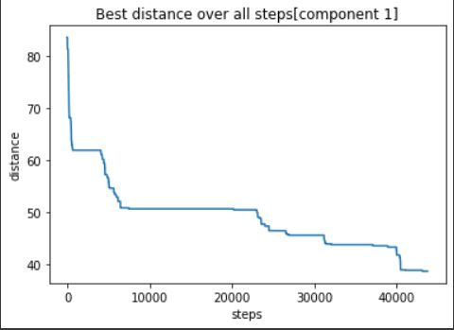
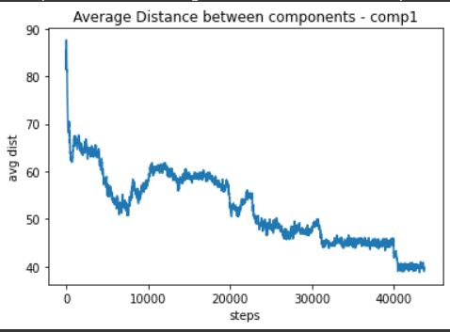
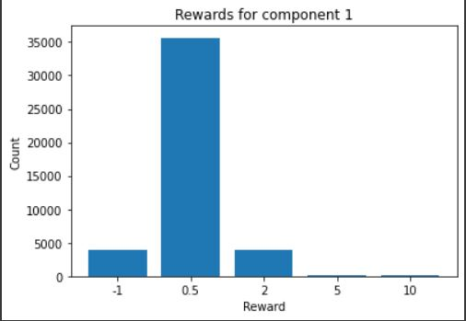
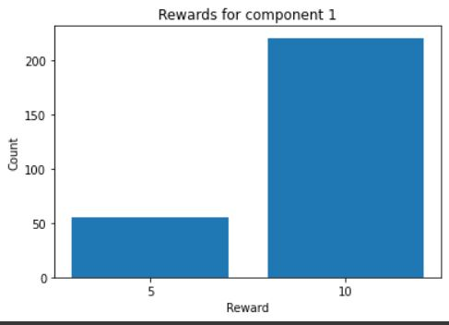
Appendix
Shared Q-Table
Single Q-Table for all the agents
Total Rewards = 100k
Objective 1 [Minimize]

Slide 18
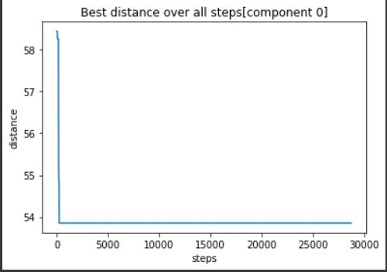
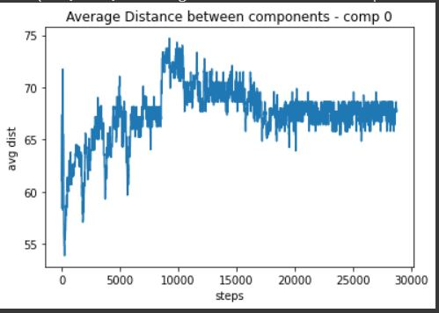
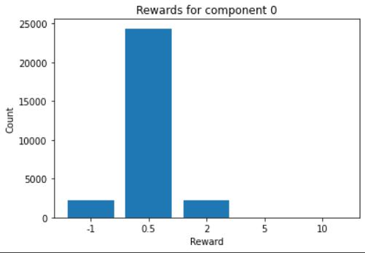
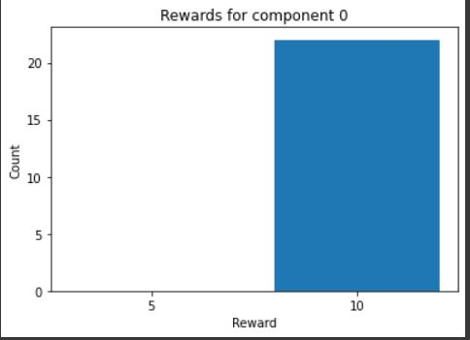
Appendix
Shared Q-Table
Single Q-Table for all the agents
Total Rewards = 100k
Objective 2 [Minimize]

Slide 19
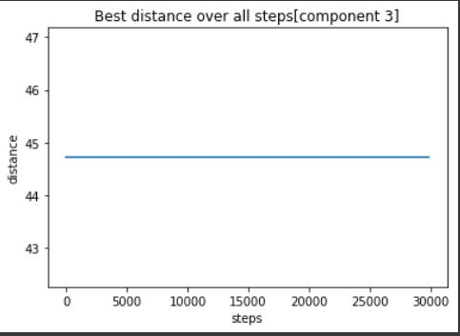
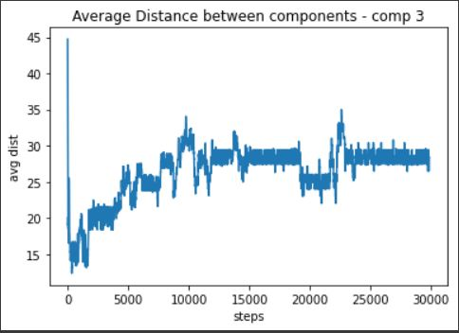
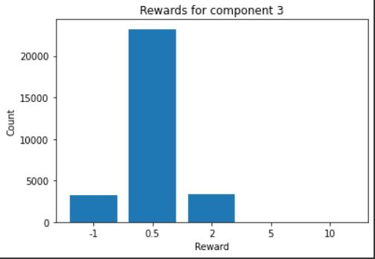
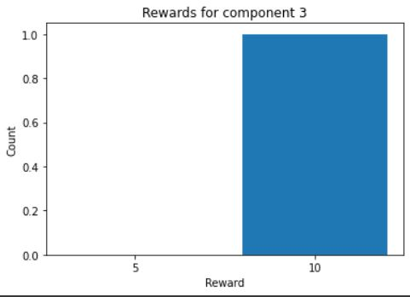
Appendix
Shared Q-Table
Single Q-Table for all the agents
Total Rewards = 100k
Objective 3 [Maximize]

Slide 20
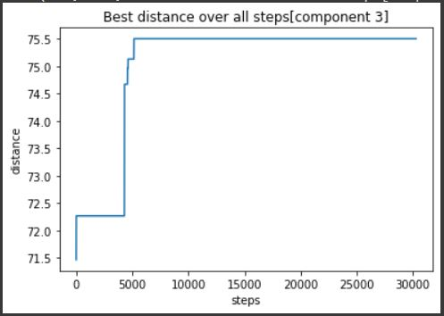
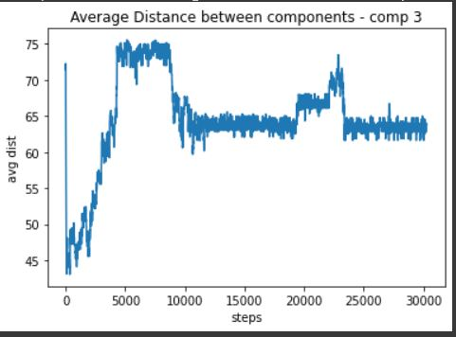
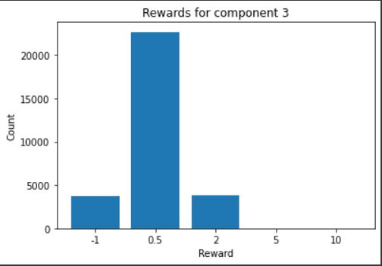
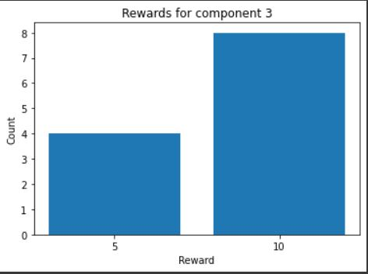
Appendix
Shared Q-Table
Single Q-Table for all the agents
Total Rewards = 100k
Objective 4 [Maximize]

Slide 21
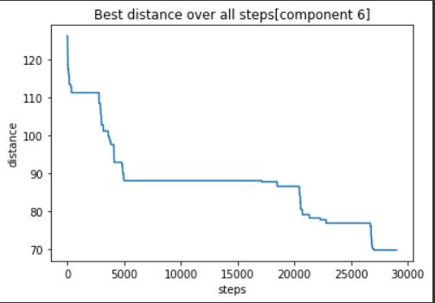
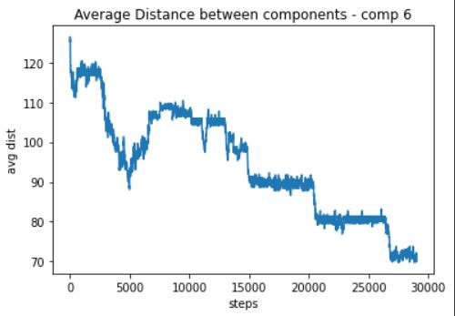
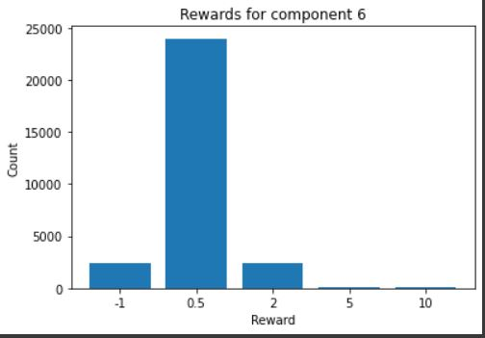
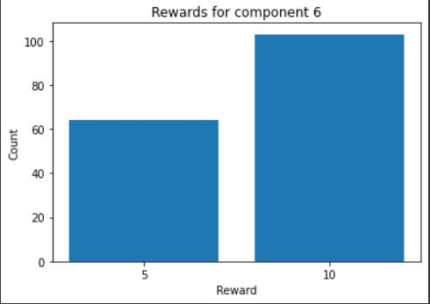
Appendix
Shared Q-Table
Single Q-Table for all the agents
Total Rewards = 100k
Objective 5 [Minimize]

Slide 22
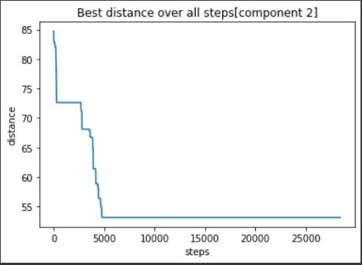
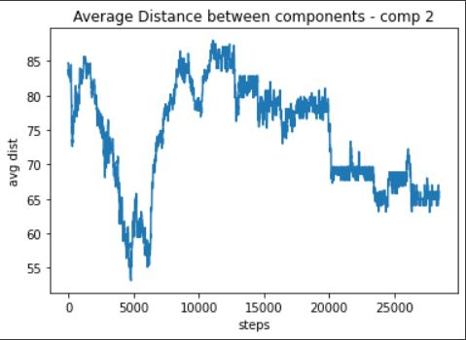
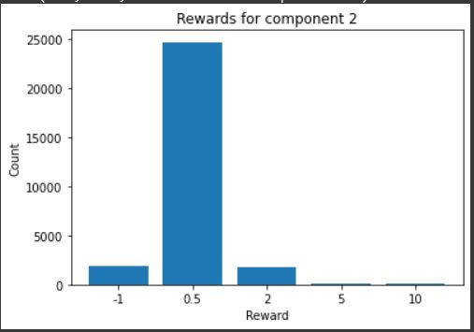
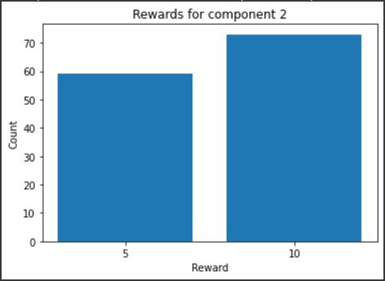
Appendix
Shared Q-Table
Single Q-Table for all the agents
Total Rewards = 100k
Objective 6 [Minimize]

Slide 23
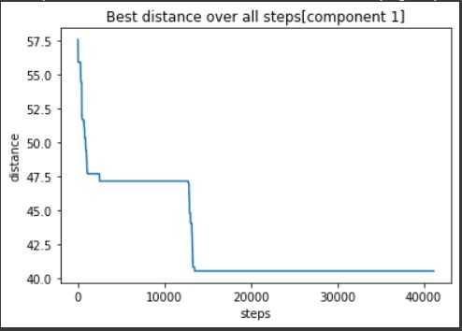
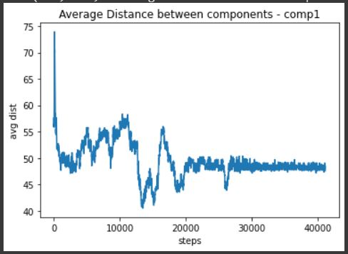
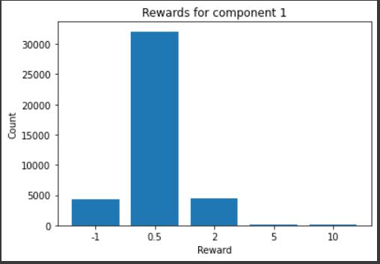
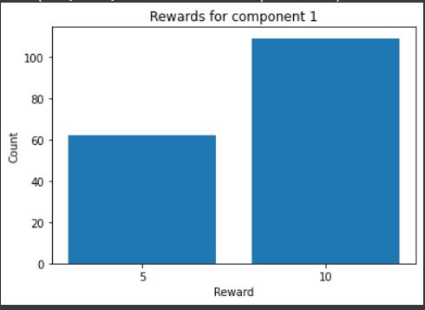
Appendix
Different Q-Table
Different Q-Table for each agents
Total Rewards = 100k
Objective 1 [Minimize]

Slide 24
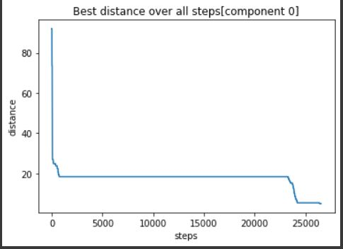
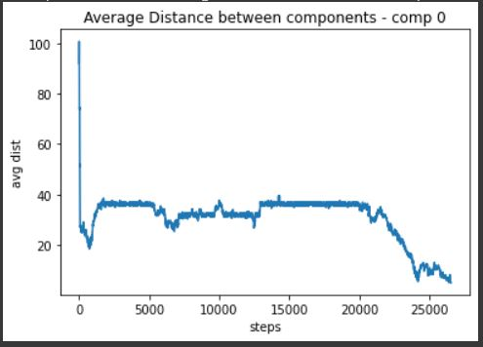
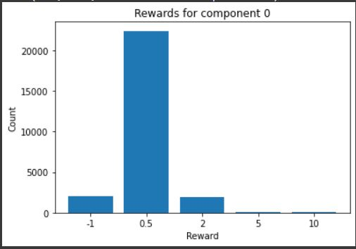
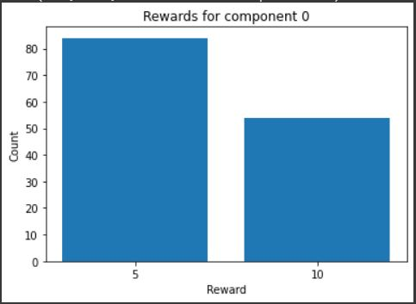
Appendix
Different Q-Table
Different Q-Table for each agents
Total Rewards = 100k
Objective 2 [Minimize]

Slide 25
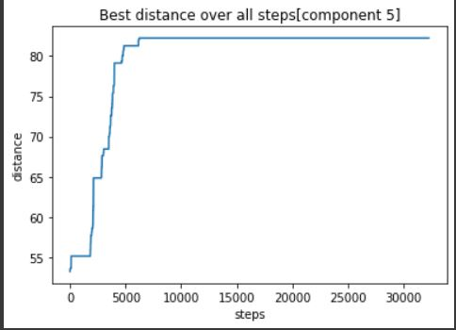
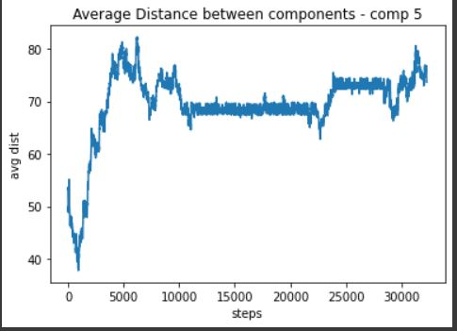
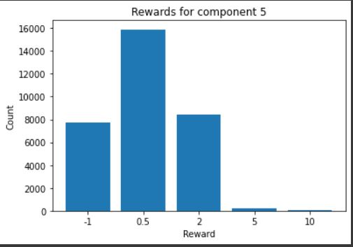
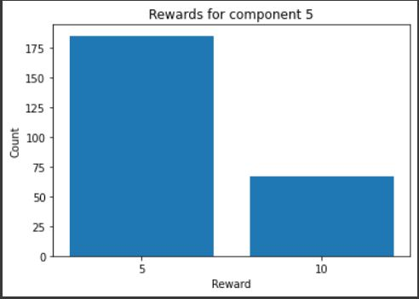
Appendix
Different Q-Table
Different Q-Table for each agents
Total Rewards = 100k
Objective 3 [Maximize]

Slide 26
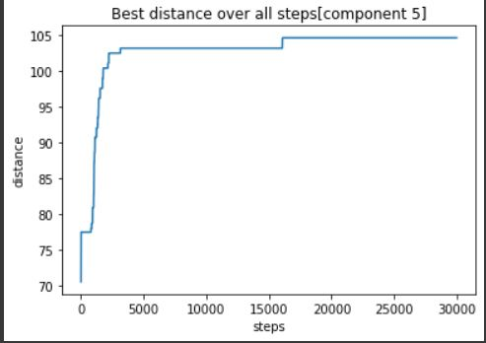
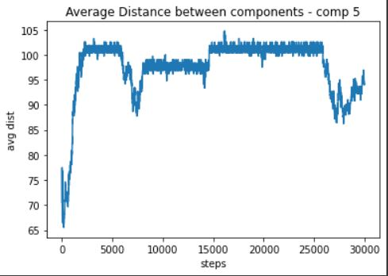
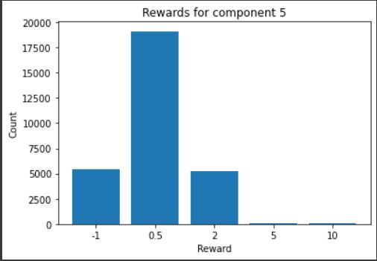
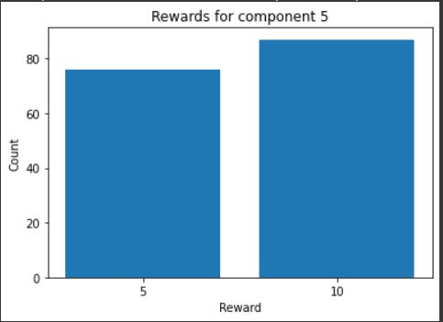
Appendix
Different Q-Table
Different Q-Table for each agents
Total Rewards = 100k
Objective 4 [Maximize]

Slide 27
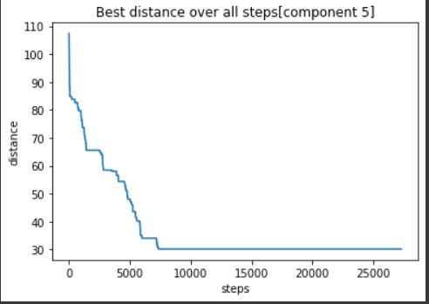
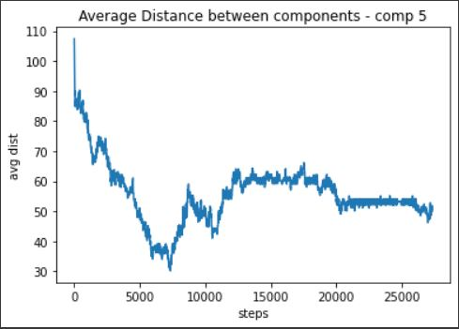


Appendix
Different Q-Table
Different Q-Table for each agents
Total Rewards = 100k
Objective 5 [Minimize]

Slide 28




Appendix
Different Q-Table
Different Q-Table for each agents
Total Rewards = 100k
Objective 6 [Minimize]

